Slide 1

Hospital Management system
Full-stack project review
E VISHAL 20cs1035
JEEVARAMANAN M 20cs1050
SUNIL A 20cs2006
A Digital Way for Healthier Lifestyle​​

Slide 2
Problem statement
Inefficient And Outdated Hospital Management Systems Can Result In Poor Patient Care, Increased Costs, And Reduced Productivity
Manual Processes, Lack Of Integration Between Systems, And Data loss, Can Lead To Errors, Delays, And Ineffective Resource Allocation
There Is A Need For A Comprehensive And Integrated Hospital Management System That Can Streamline Operations
Improve Communication, And Provide Real-time Access To Patient Information
Thereby Enhancing Patient Outcomes And Reducing Costs

Slide 3





objectives
Patients
Doctors
To easily manage their Health records online in a safer and efficient way and can be used for treatments across multiple doctors and multiple hospitals.
Medical professionals can easily access patients medical records electronically across devices and treat their patients in real time.
appointments
Prescription and billing
Imagine of saving your time by waiting in queue for getting a appointment or traditional method of calling a tollfree no and booking appointments by booking appointments in real time, Hassle Free
All your Prescriptions and Bills will be completely Generated Online Based on the Facilities and Treatments taken by the Patient and Records will be stored online for future Use.

Slide 4
Technology Stack
Type | Tech Used
Frontend | ReactJs
Backend | SpringBoot
Database | MySQL
ORM Mapping | JPA (Hibernate)
Testing | Junit, Mockito
Code Coverage | EclEmma, Jococo

Slide 5

Project Overview
Uniqueness
First to Implement
We are trying to integrate this HMS to Health Id issued by GOI thereby creating a Ecosystem for a Healthier Environment
Our HMS is the First in Segment to implement Fully Digital and Microservices Based App so that even if one service fails, other service works
Testing
Authentic
Planning to Conduct testing with local hospitals in the area and with local Doctors
Designed with the help and input of medical experts in the field ​and the issues faced by Patients

Slide 6
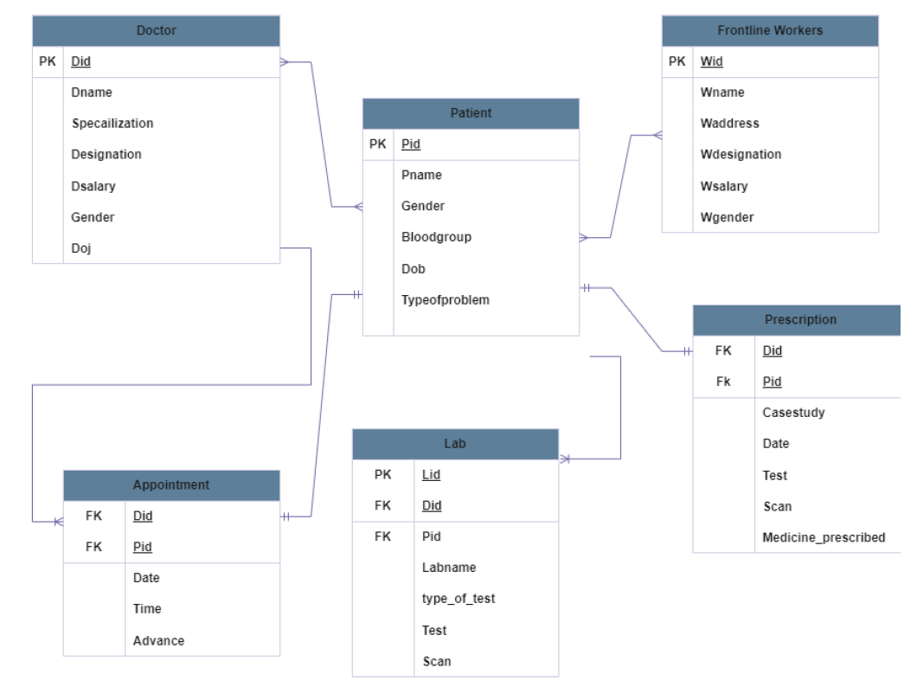
Entity relationship diagram

Slide 7
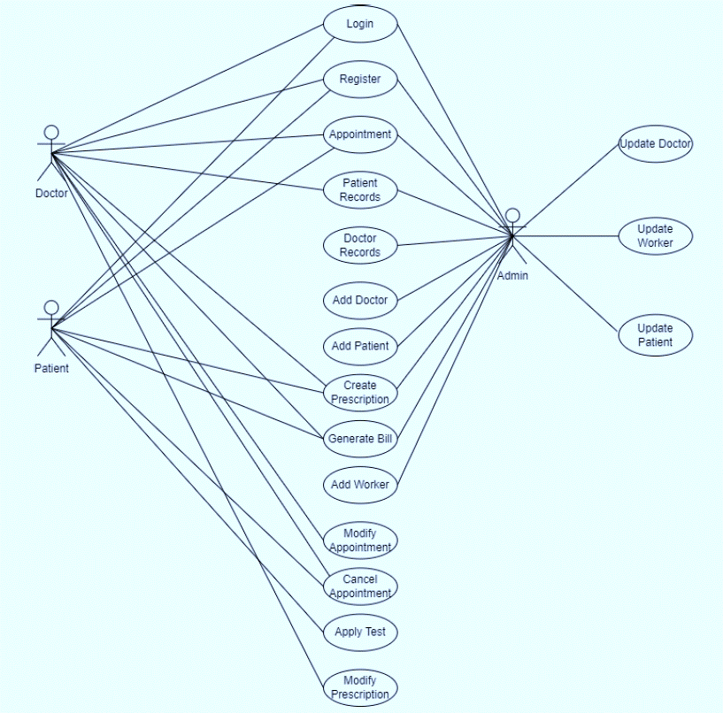
Use case diagram

Slide 8
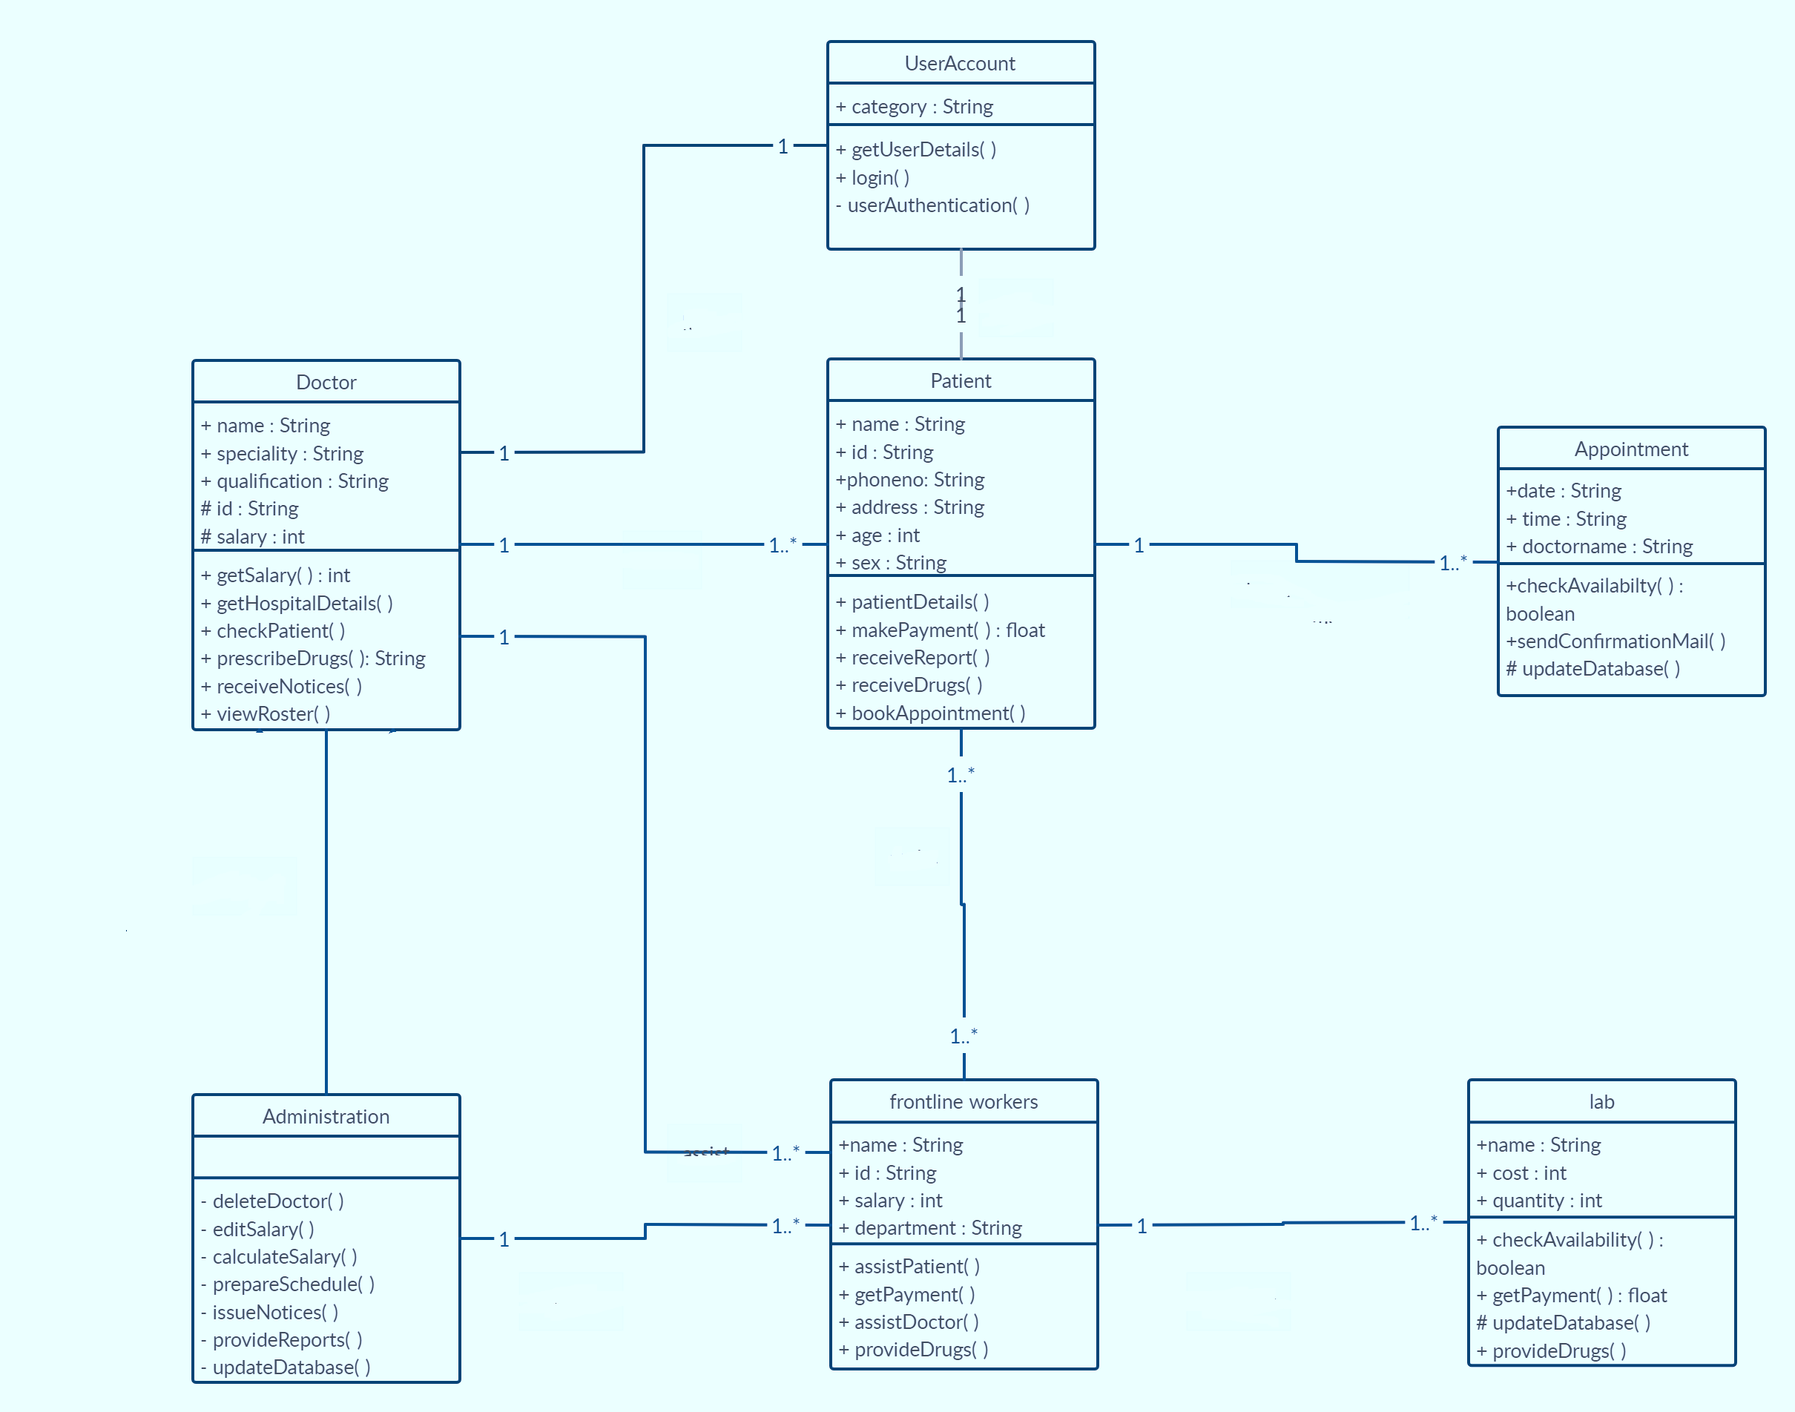
Class diagram

Slide 9
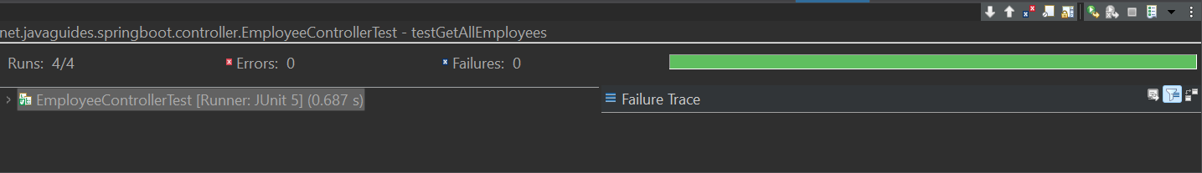
Patient service code testing

Slide 10
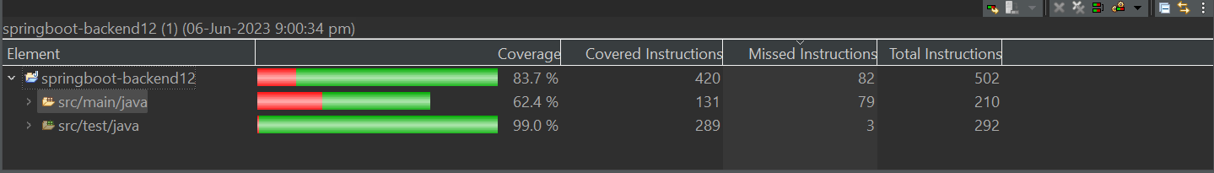
Patient service code coverage

Slide 11
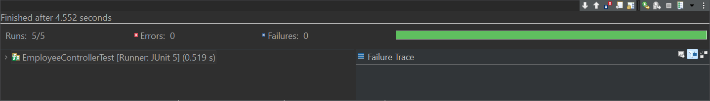
Doctor service code testing

Slide 12
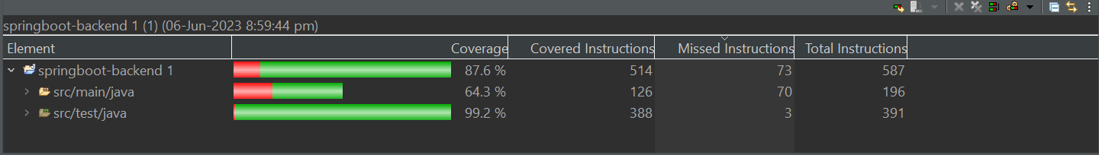
Doctor service code coverage

